Slide 1

FORECASTING ELECTRICITY DEMAND
by-
Mudita Garg

Slide 2


INTRODUCTION
Lockdown measures have significantly reduced electricity demand, affecting in turn the power mix. Increases in residential demand were far outweighed by reductions in commercial and industrial operations.
Daily data collected for more than 30 countries, representing over one-third of global electricity demand, show that the extent of demand declines depends on the duration and stringency of lockdowns. On average we find that every month of full lockdown reduced demand by 20% on average, or over 1.5% on an annual basis.

Slide 3
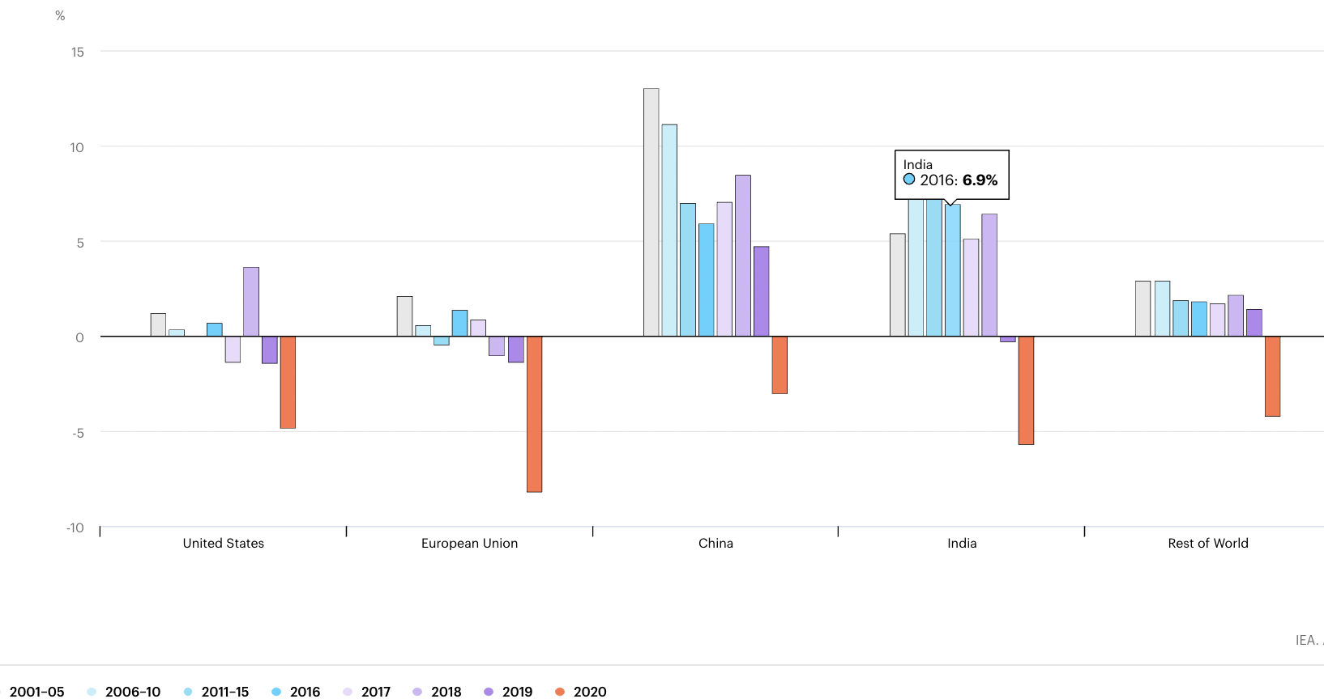
Annual average growth rates of electricity demand in selected regions, 2001-2020
Notes:
In economies that rely more heavily on industry, lockdown measures have less effect on electricity demand. In China, industry accounted for more than 60% of electricity consumption in 2019, compared with 10% for services, part of the reason that it would experience a smaller impact on overall electricity demand. In the United States, industry only accounts for 20% of electricity demand, while the services sector accounts for almost 40%, leading to more pronounced impacts on total electricity demand as non-essential services have been hit the hardest by lockdown measures. Europe is set to feel the largest impact as hard-hit services sectors play a central role in its economy.

Slide 4
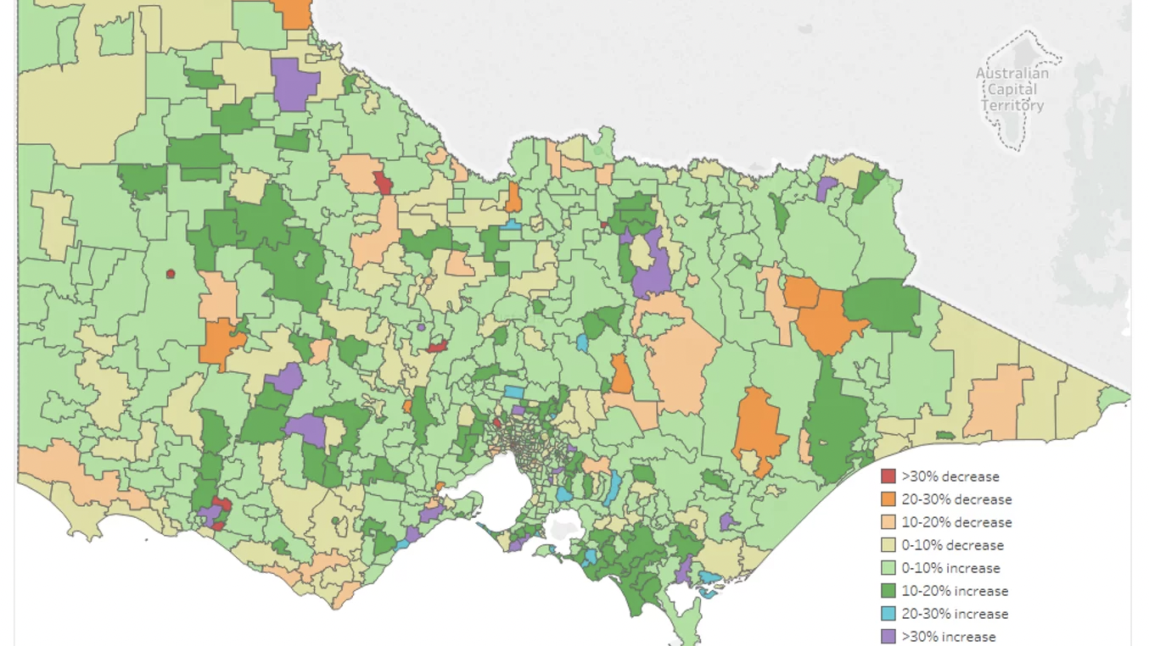
Total changes in consumption in Victoria, Australia
The maps for total consumption for April through to June, show how demand in Victoria has changed throughout the pandemic and demonstrates the how significant events, such as bushfires and pandemics change how and where we use electricity.
The maps from April to June, show how the lifting of restrictions in Victoria changed consumption.

Slide 5
LITERATURE REVIEW
Application of residual modification approach in seasonal ARIMA for electricity demand forecasting: A case study of China Yuanyuan Wang , Jianzhou Wang, Ge Zhao, Yao Dong
Although a seasonal ARIMA model is widely used in electricity demand analysis and is a high-precision approach for seasonal data forecasting, errors are unavoidable in the forecasting process. Consequently, a significant research goal is to further improve forecasting precision. In this study, PSO optimal Fourier method, seasonal ARIMA model and combined models of PSO optimal Fourier method with seasonal ARIMA are applied in the Northwest electricity grid of China to correct the forecasting results of seasonal ARIMA. The results indicate that the prediction accuracy of the three residual modification models is higher than the single seasonal ARIMA model and that the combined model is the most satisfactory of the three models.[1]

Slide 6
Short-term electricity demand forecasting with MARS, SVR and ARIMA models using aggregated demand data in Queensland, Australia
Mohanad S. Al-Musaylha,b,⁎ , Ravinesh C. Deoa,d,⁎ , Jan F. Adamowskic , Yan Lia
Data-driven techniques for short-term G-data forecasting are used for 0.5 h, 1.0 h and 24 h forecasting horizons in this analysis. The research focuses on the second largest state of Australia, Queensland, with a growing demand for electricity for end-users. The partial autocorrelation function was applied during the training period to evaluate MARS and SVR models inputs for the historical G data, to distinguish significant inputs.
In relation to measurable data G, the accuracy of G forecasting is evaluated using statistical metrics such as Pearson Product Moment, Root Square Error and Mean Absolute Error correction coefficients. The SVR model, on the other hand, is superior to the MARS and ARIMA for the regular horizon which shows a wider WI and MAE. Consequently, the MARS and SVR models in Queensland, Australia can be found to be more appropriate than the ARIMA model for short-term G forecasts. They are also useful scientific instruments for further exploring the data forecasting of demand for energy in real-time.[2]

Slide 7
Forecasting mid-long term electric energy consumption through bagging ARIMA and exponential smoothing methods
Erick Meira de Oliveira a, b, * , Fernando Luiz Cyrino Oliveira a
In the last decades, the world's energy consumption has increased rapidly due to fundamental changes in the industry and economy. This paper expands the fields of application of combined Bootstrap aggregating (Bagging) and forecasting methods to the electric energy sector, a novelty in literature, in order to obtain more accurate demand forecasts. The results show that the proposed methodologies substantially improve the forecast accuracy of the demand for energy endues services in both developed and developing countries.
The demand for electricity is forecasted 24 months in advance in various countries. The prospects of bagging technology are discussed to improve forecasting. The bagging process is proposed to be changed again. In certain cases, predictions were consistent with the methods suggested. [3]

Slide 8
Review analysis of COVID-19 impact on electricity demand for residential buildings
Weather adjusted time series data of electricity demand before and after COVID-19 lockdowns are used to determine the magnitude of changes in electricity demand and residential energy use patterns. The analysis results indicate that while overall electricity demand is lower because of lockdowns that impact commercial buildings and manufacturing sectors, the energy consumption for the housing sector has increased by as much as 30% during the full 2020 lockdown period. Analysis of reported end-use data indicates that most of the increase in household energy demand is due to higher occupancy patterns during daytime hours, resulting in increased use of energy intensive systems such as heating, air conditioning, lighting, and appliances. Several energy efficiency and renewable energy solutions are presented to cost-effectively mitigate the increase in energy demands due to extended stay home living patterns.
The impacts of lockdowns and stay home orders due to COVID-19 on global electricity demand are discussed. Data for specific US regions and residential building stocks are obtained and analyzed. Specific sets of recommendations to improve the indoor air quality and energy efficiency for existing homes are outlined. [4]

Slide 9
The application of seasonal latent variable in forecasting electricity demand as an alternative method
Kutluk KaganSumer, Ozlem Goktas, AycanHepsag
In this study, we used ARIMA, seasonal ARIMA (SARIMA), and alternatively the regression model with a seasonal latent variable in forecasting electricity demand by using data that belongs to ‘‘Kayseri and Vicinity Electricity Joint-Stock Company’’ over the 1997:1–2005:12 periods. This study tries to examine the advantages of forecasting with ARIMA, SARIMA methods and with the model has seasonal latent variable to each other. The results support that ARIMA and SARIMA models are unsuccessful in forecasting electricity demand.
Seasonal ARIMA (SARIMA) is an extension of autoregressive integrated moving average (ARIMA), where seasonality in the data is accommodated using seasonal difference (Goh and Law, 2002). Also in applied studies, it is possible to model the seasonal and non-seasonal processes together through seasonal Box-Jenkins (SARIMA) models.[5]

Slide 10
HYPOTHESIS
This analysis will provide Victorians an insight into how much electricity is consumed in comparison with previous years to the current year.
The data set contains 14 variables, but we are using Date, Demand and RRP.
We will plot time series against date and demand and date and RRP.
H0 (Null hypothesis) :
The model show a lack of fit (or in simple terms—the model is not fitting appropriately.)
The difference between the demand and rrp (price) will decrease or remain constant.
H1(Alternate hypothesis):
The model is appropriate and adequate.
Forecasting demand of electricity for year 2020 by using 2015-2019 data.
The difference between the demand and rrp (price) will increase.

Slide 11
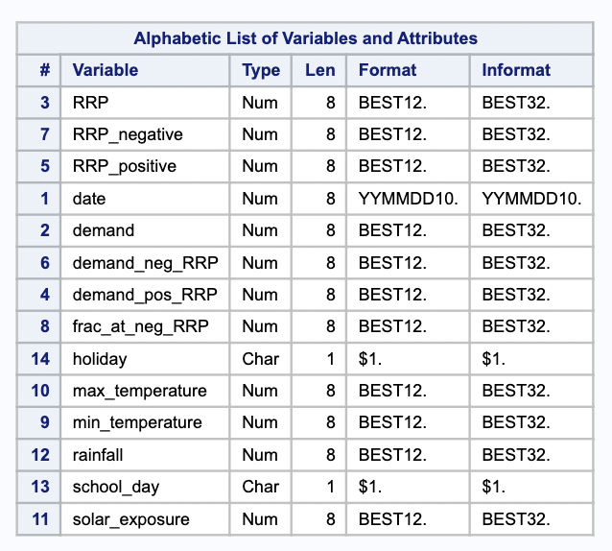
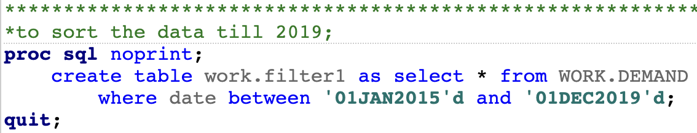
INSIGHTS ABOUT DATASET
Source of the Dataset- https://www.kaggle.com/aramacus/electricity-demand-in-victoria-australia
The dataset contains various parameters like demand, rainfall, solor_exposure, RRP,etc
We have chosen Date with Demand and RRP to plot the time series and do the analysis.
The dataset is from 2015-2020, so we will first convert the daily data to monthly and then segregate the data into different parts.
PART 1: Monthly data from 2015-2019
PART 2: 2020 Data
There are no missing values in the dataset.
There were no outliers in the variable demand.

Slide 12
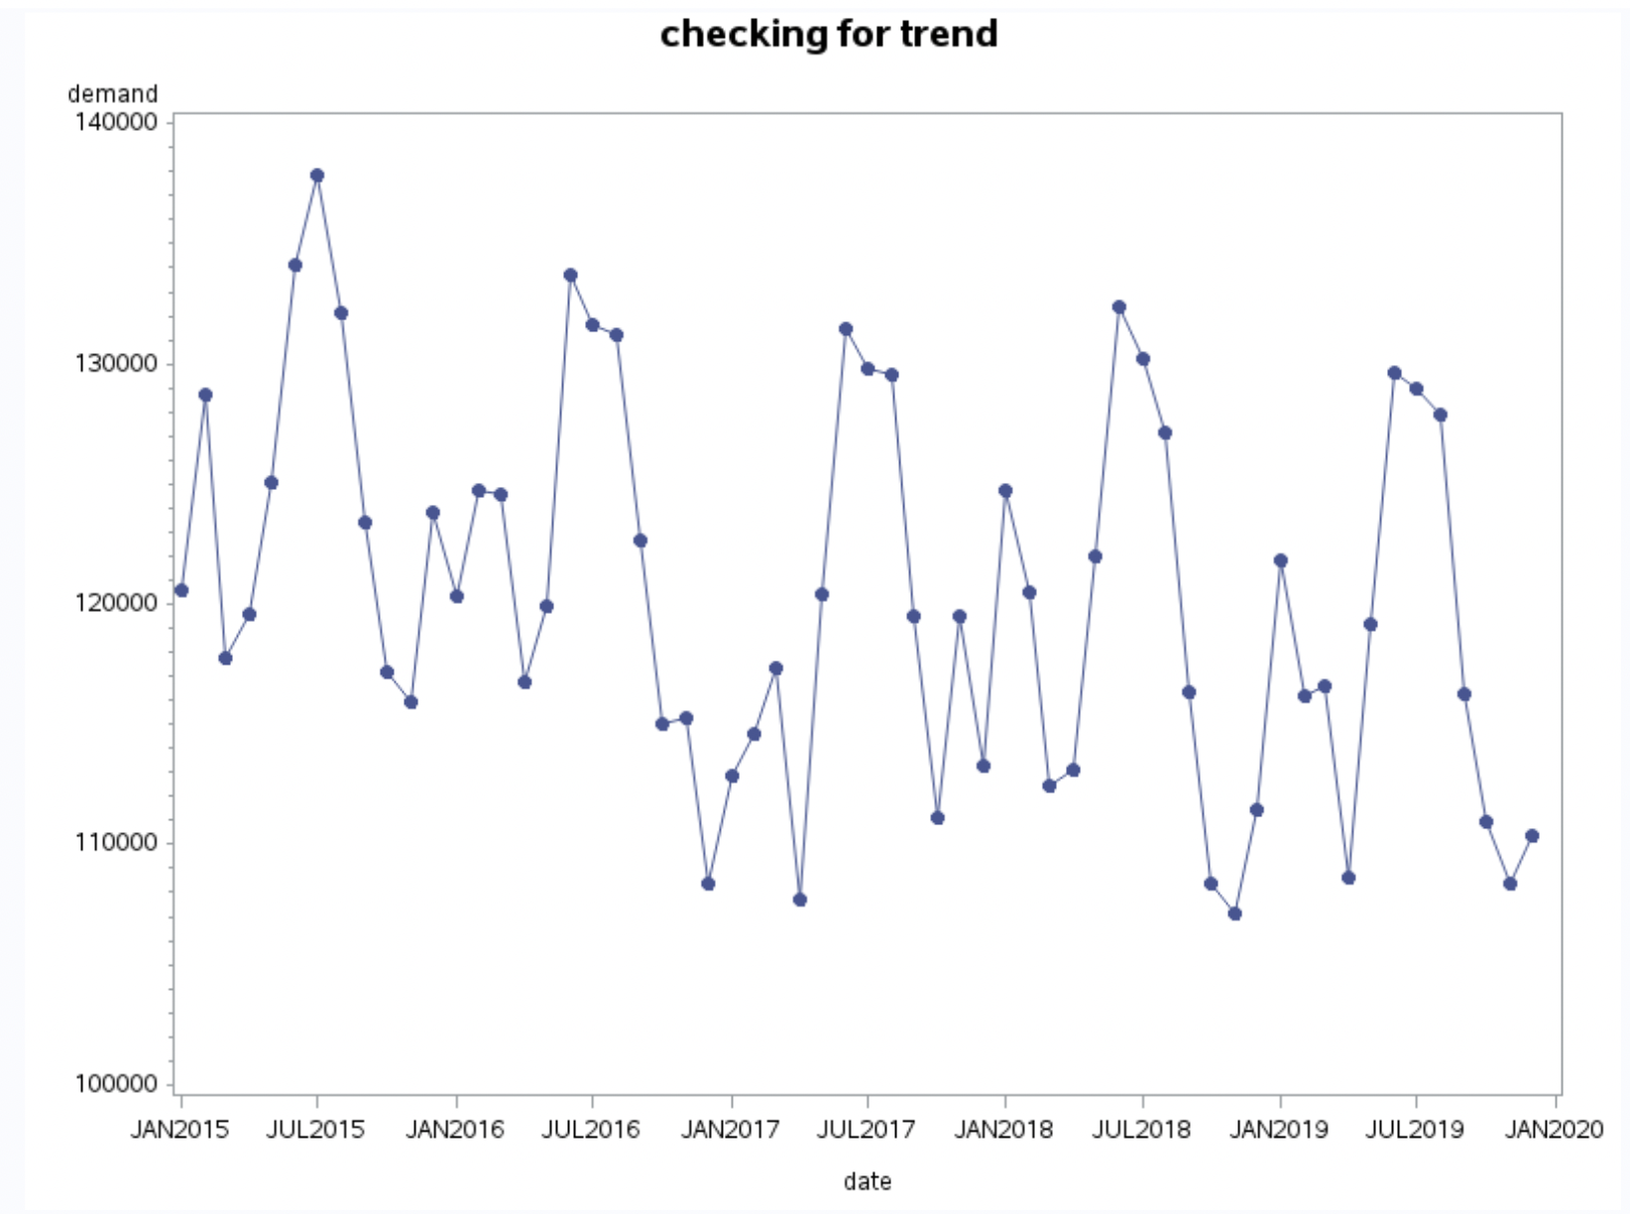
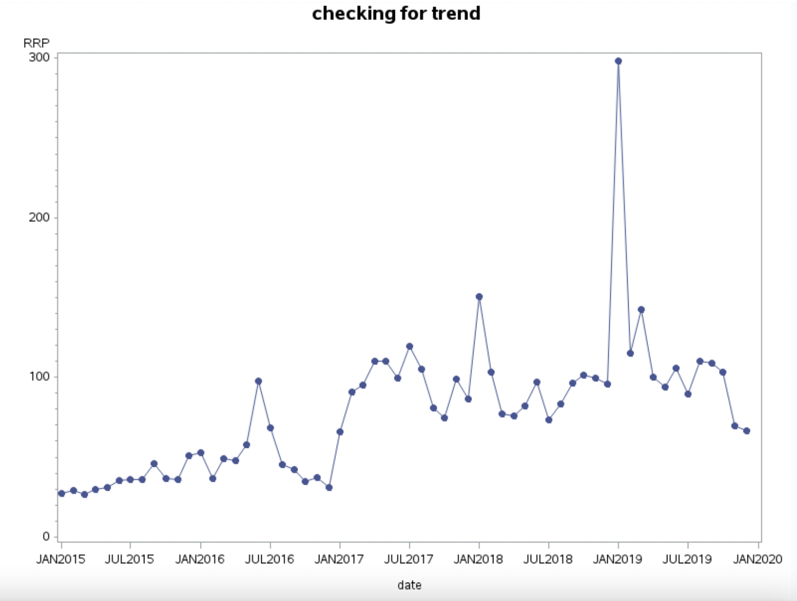
TREND OF THE TIME SERIES
There is a decrease in the trend this means that the demand has reduced over time. As you can see in the graph, the peaks are in the months of June-July which makes sense as the weather is hot thus due to Air conditionings the demand is high.
There is an increase in the trend this means that the retail price has increased over time. As you can see in the graph, the peaks are very random in order, this means there is no fixed period of increasing retail price. Jan 2019 seems to be an outlier in the trend series.

Slide 13
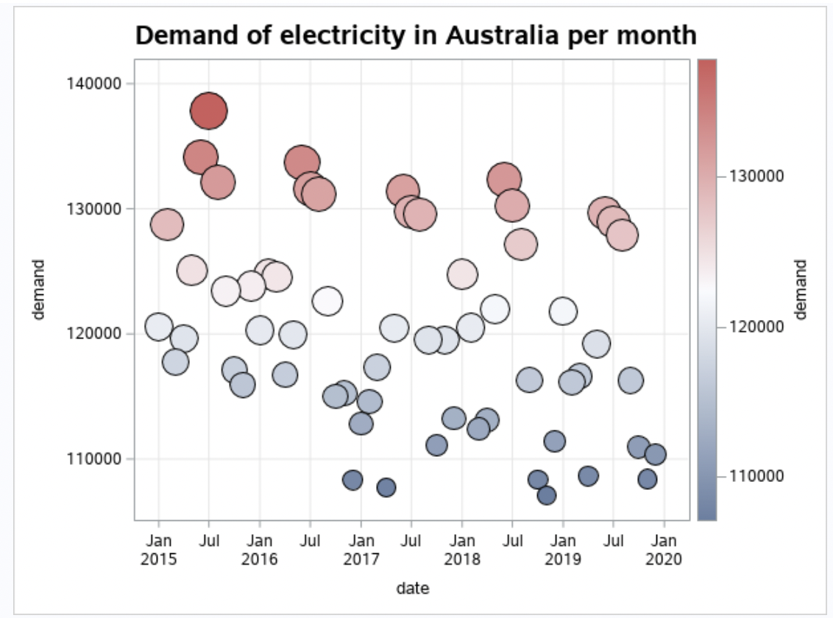
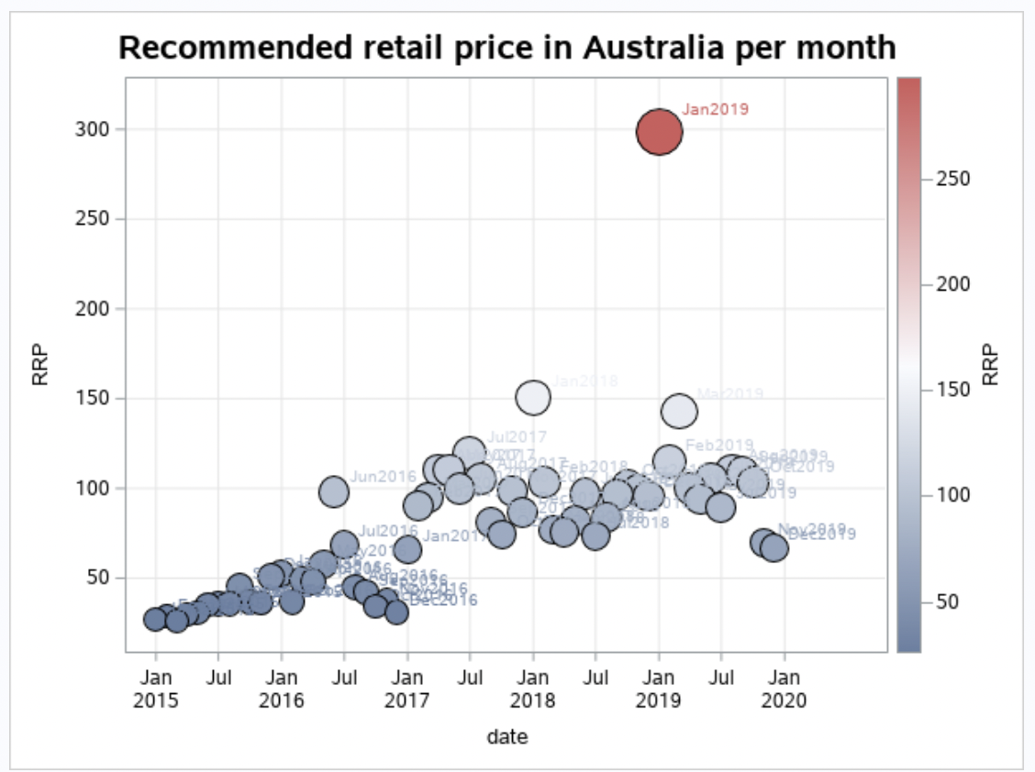
BUBBLE CHART INTERPRETATION
In the demand vs date plot, there has been decrease in demand of electricity during the year 2019-2020.
In this plot, there has been increase in the retail price of electricity during the year 2019-2020. Jan 2019 seems to be an outlier.

Slide 14
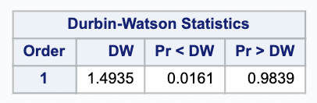
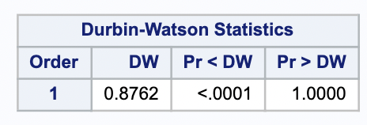
AUTOCORRELATION TEST
The Durbin-Watson test is a widely used method of testing for autocorrelation. The first-order Durbin-Watson statistic is printed by default.
The Durbin-Watson Test is a test for serial correlation in the errors ε1, ε2, . . . , εn.
This is a type of dependence or relationship among the errors εt , which is a violation of the assumption of independence.
Positive serial correlation occurs when neighboring errors (in time) εt and εt+1 tend to be similar. With positive serial correlation, positive errors tend to be followed by positive errors, and negative errors followed by negative errors.
Negative serial correlation occurs when neighboring errors (in time) tend to be dissimilar. With negative serial correlation, positive errors tend to be followed by negative errors, and negative errors followed by positive errors.
Positive serial correlation leads to DW < 2.
Negative serial correlation leads to DW >2
Test for RRP , which is positive auto correlation
Test for Demand , which is positive auto correlation.

Slide 15
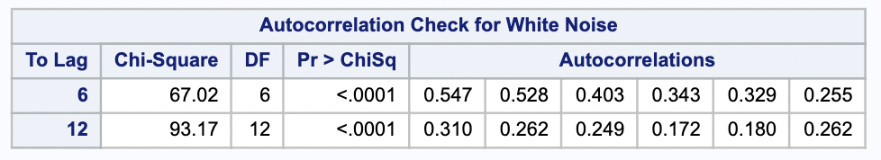
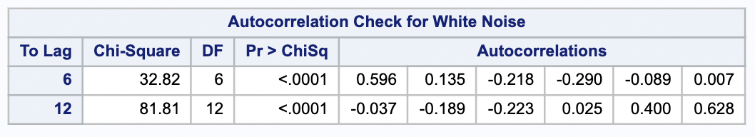
WHITE NOISE TEST
White noise is an approximate statistical test of the hypothesis that none of the autocorrelations of the series up to a given lag are significantly different from 0. If this is true for all lags, then there is no information in the series to model, and no ARIMA model is needed for the series.
The Correlation for demand with 1st Lag indicates towards the presence of trend and that with 12th lag indicates an annual seasonality. Hence, we can consider differencing at first and Twelfths orders.
The Correlation for RRP with 1st lag indicates towards the presence of trend, Hence we will consider differencing at first order.
Since, the variables are not stationary yet, thus the p-values are less than alpha.
RRP Auto Correlation for white noise
Demand Auto Correlation for white noise

Slide 16
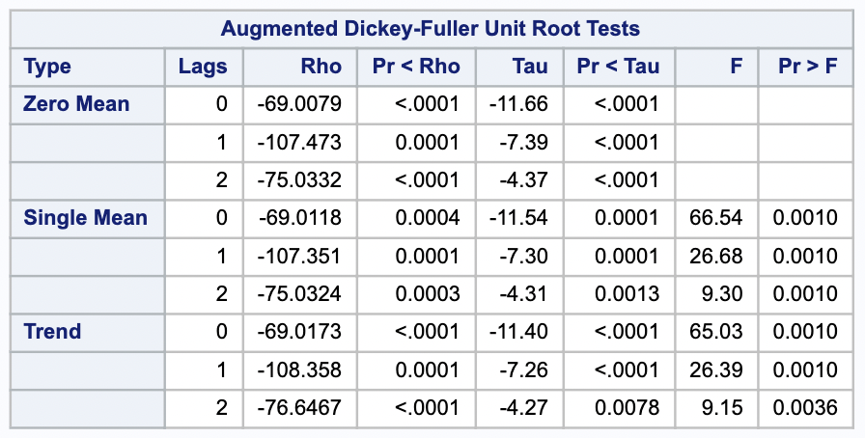
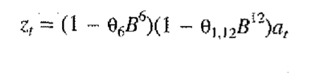
STATIONARITY TEST
Null Hypothesis : Non-Stationary
Alternative Hypothesis : Stationary
There are three types by which you can calculate test statistics of dickey-fuller test-
Zero Mean - No Intercept. Series is a random walk without drift.
Single Mean - Includes Intercept. Series is a random walk with drift.
Trend - Includes Intercept and Trend. Series is a random walk with linear trend.
We can check the stationarity test by :
proc arima data = work.filter1;
identify var = demand(1) stationarity = (adf);
identify var = demand(1,12) stationarity = (adf) ;
run;
We check the pr<tau values, and all the values are less than alpha thus the differencing is stationary.
We have used this equation for differencing our demand variable.

Slide 17
SCAN ESCAF MINIC
The smallest canonical (SCAN) correlation method can tentatively identify the orders of a stationary or nonstationary ARMA process. Given a stationary or nonstationary time series {zt:1≤t≤n} with mean corrected form z~t=zt−μz with a true autoregressive order of p+d and with a true moving-average order of , you can use the SCAN method to analyze eigenvalues of the correlation matrix of the ARMA process.
The extended sample autocorrelation function (ESACF) method can tentatively identify the orders of a stationary or nonstationary ARMA process based on iterated least squares estimates of the autoregressive parameter
The minimum information criterion (MINIC) method can tentatively identify the order of a stationary and invertible ARMA process. with a true autoregressive order of p and with a true moving-average order of q, you can use the MINIC method to compute information criteria (or penalty functions) for various autoregressive and moving average orders

Slide 18
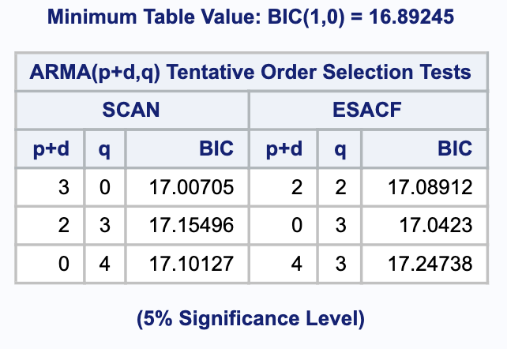
SCAN: As you can see in the table, the scan method suggests us that we should use p+d=3 q=0. Here p means AR model, q means MA model and d is differencing.
So, we can use differencing (2) + p(1) for estimating the model. Similarly, we can check for other options as well.
MIMIC:
We check the lowest value in the table, here our lowest value comes out to be 16.8 which suggests that BIC(1,0). It means that we can use p=1 maximum order and q=0.

Slide 19
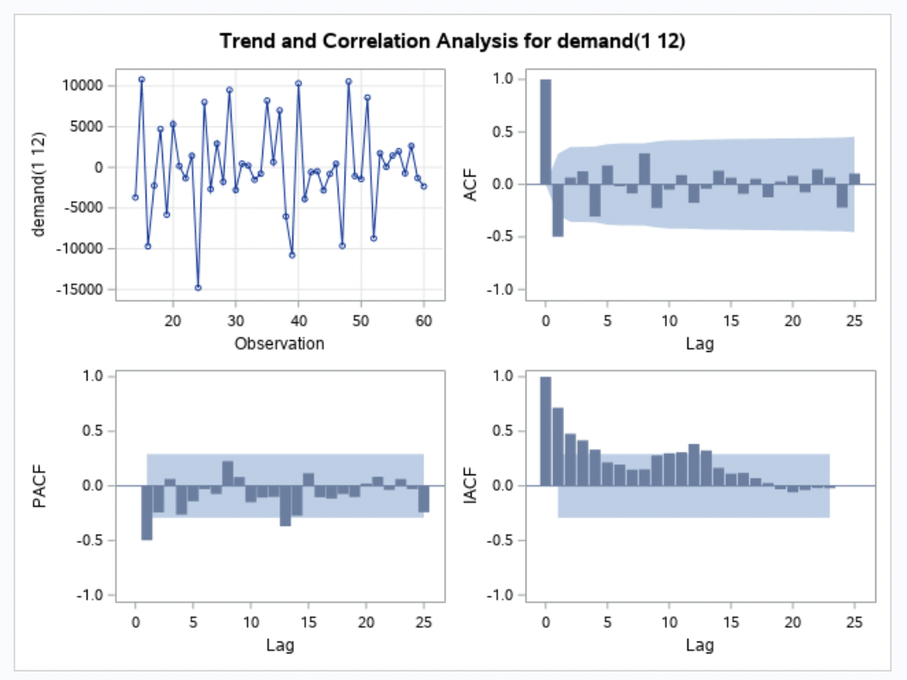
PROC ARIMA
ARIMA stands for auto-regressive integrated moving average. It is also known as the Box-Jenkins model, as the ARIMA has been technique popularized by Box and Jenkins. For ARIMA forecasting, data needs to be stationary.
The ARIMA procedure analyzes and forecasts equally spaced univariate time series data, transfer function data, and intervention data by using auto-regressive integrated moving averages.
Identification Stage
The Identification Stage computes auto-correlation, inverse autocorrelations, partial autocorrelations, and cross-correlations. Stationarity tests can be performed to identify whether differencing is necessary. It also provides descriptive statistics.
When we identify the demand variable in the time series:
ACF PLOT (SAC)- Spike at lag 1
PACF PLOT (SPAC)- Spike at lag 1,13

Slide 20
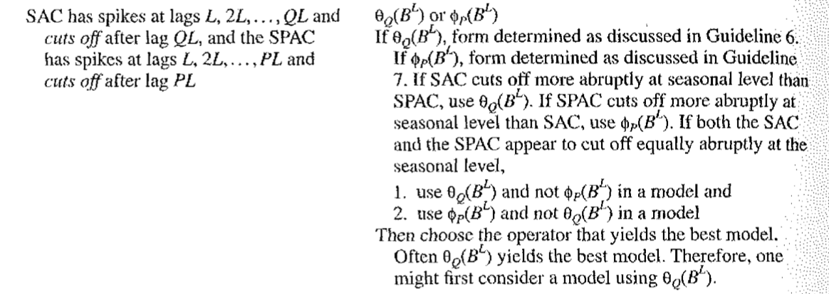
We identified the lags and referred our course material, and found out that we are using seasonal operators, so according to these we will estimate our model.
According to the Book, our lags at SAC and SPAC are dying down abruptly so we can use MA(1) and AR(1) for estimation.

Slide 21
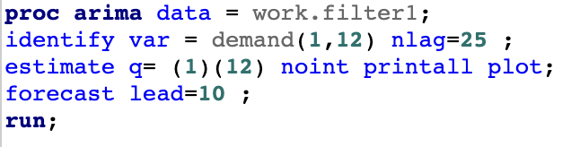
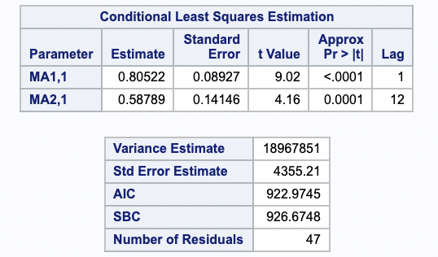
Estimation and Diagnostic Stage
The estimate statement is used to specify the ARIMA model to fit to the variable specified in the previous identify statement and to estimate the parameters of that model.
The estimate statement also produces diagnostic statistics to help you judge the adequacy of the model.
Ljung-Box test
• Ljung-Box test is an important diagnostic to check if residuals from the time series model are independently distributed. In SAS, it is easy to perform Ljung-Box with the ARIMA procedure.
Ljung Box Test Hypotheses
H0: null hypothesis :
The model does not show lack of fit (or in simple terms—the model is just fine).
Ha: The alternate hypothesis :
The model does show a lack of fit. A significant p-value in this test rejects the null hypothesis that the time series isn’t autocorrelated.

Slide 22
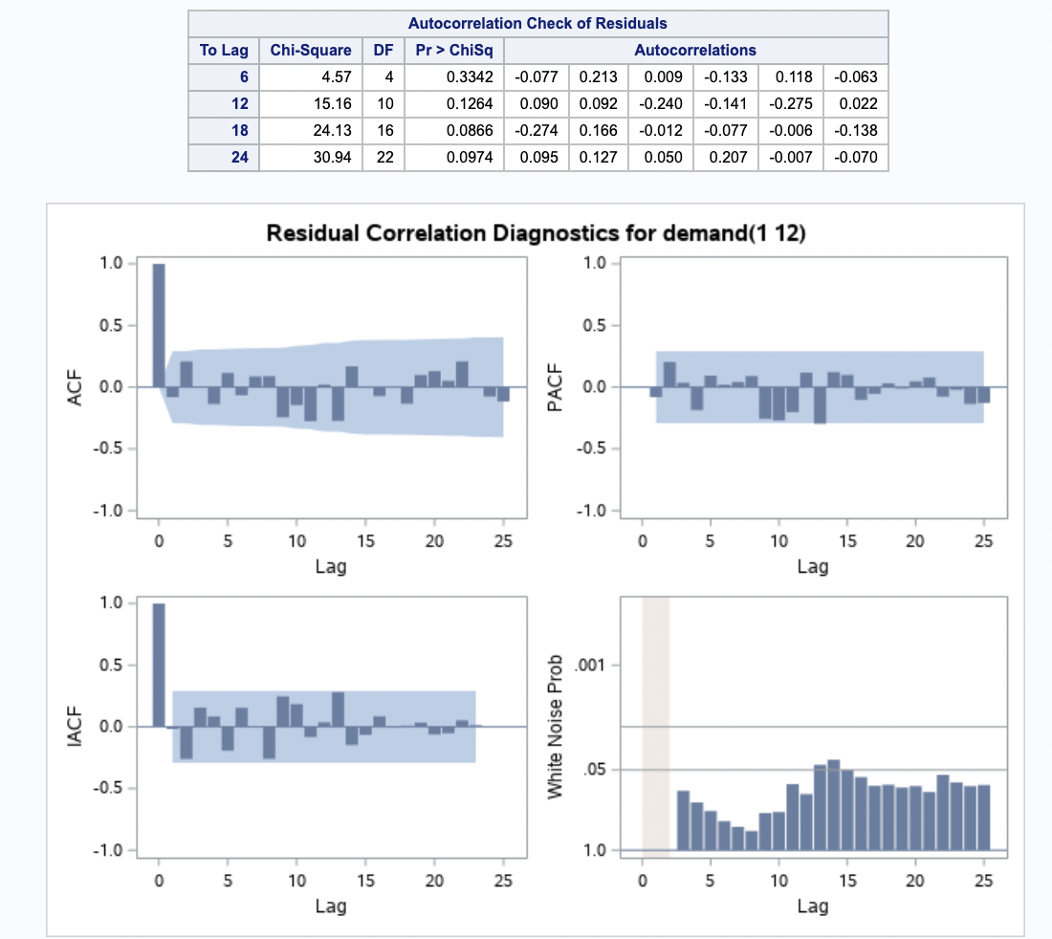
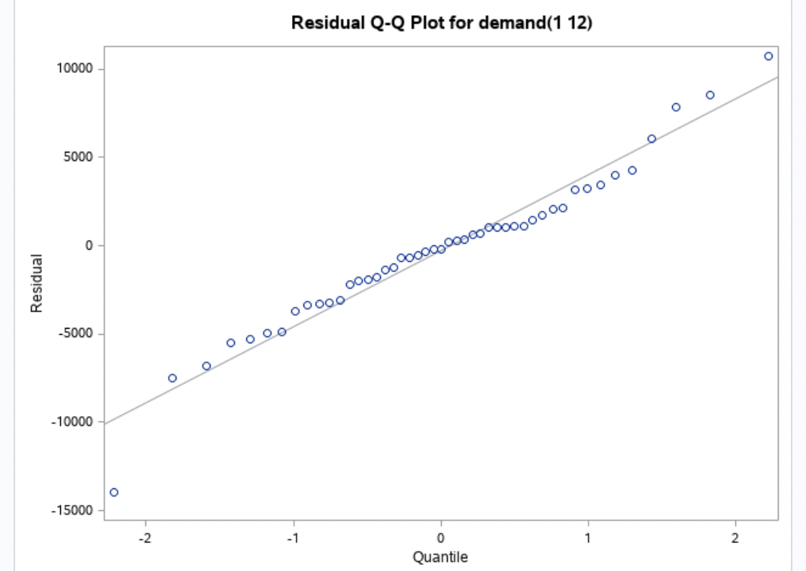
The p-values are greater than alpha which states that the model used is adequate.
The q-q plot also seems fine.
AIC of this model is lesser than the other models.

Slide 23
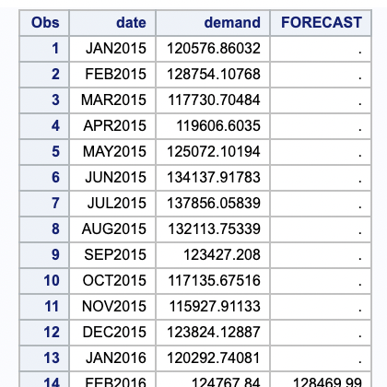
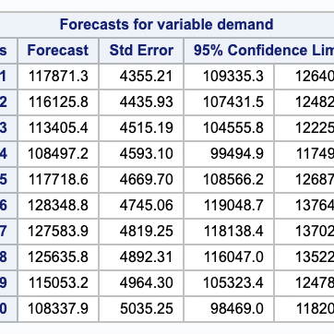
Forecasting Stage
The FORECAST statement is used to forecast future values of the time series and to generate confidence intervals for these forecasts from the ARIMA model produced by the preceding ESTIMATE statement.
lead specifies how many period ahead to forecast. (12 months is our example).
id specifies the ID variable (which is generally SAS date, time, and datetime).
interval indicates the data are monthly.
out allows us to write the forecast data to the datasets results.
In the forecasting output below, the first 13 observations are not present because we are calculating the moving average of the first few months to forecast next month.
We are forecasting from Jan 2020 to Dec 2020.
The electricity demand is decreasing due to the impact of COVID.

Slide 24
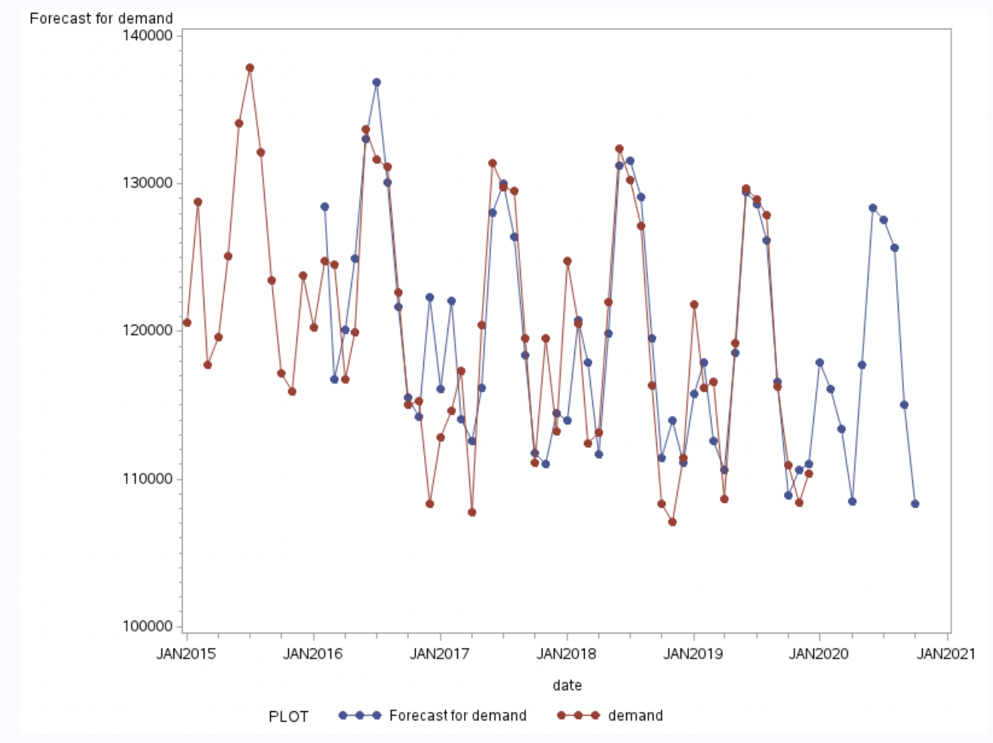
Plot of Original series and Forecasted Series

Slide 25
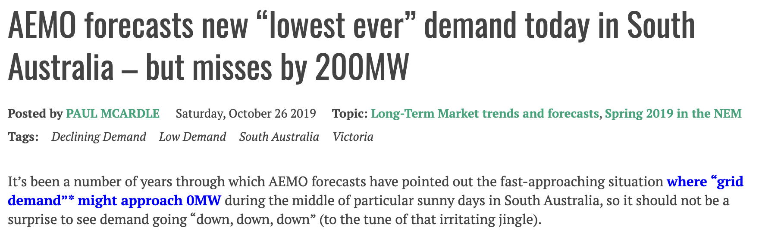
CONCLUSION
The forecasted values and the original values almost seem to overlap each other.
There is been few differences in the forecasting values and the original values because Victoria witnessed slashing of electricity demand.
The model used for estimating and forecasting time series is adequate.
The p values of white noise autocorrelation is checked, in our model the values are significant which means we will reject the null hypothesis stating that our model doesn’t fit appropriately and follow the alternative hypothesis which states that the model is adequate and fits appropriately.

Slide 26
REFERENCES
[1]. https://www.sciencedirect.com/science/article/abs/pii/S0301421512004387
[2]. https://www.sciencedirect.com/science/article/abs/pii/S1474034617301477
[3]. https://www.sciencedirect.com/science/article/abs/pii/S0360544217320820
[4]. https://www.sciencedirect.com/science/article/pii/S1364032121001829 - :~:text=The analysis results indicate that,the full 2020 lockdown period.
[5]. https://www.sciencedirect.com/science/article/abs/pii/S0301421508007143
[6]. https://towardsdatascience.com/electricity-demand-in-victoria-during-coronavirus-pandemic-30c23ff4e0d.
[7]. https://support.sas.com/documentation/onlinedoc/ets/132/arima.pdf

